Slide 1
Python Basics
““Truth can only be found in one place: the code.” -Robert Martin, Author of Clean Code
Notes:
1 min

Slide 2
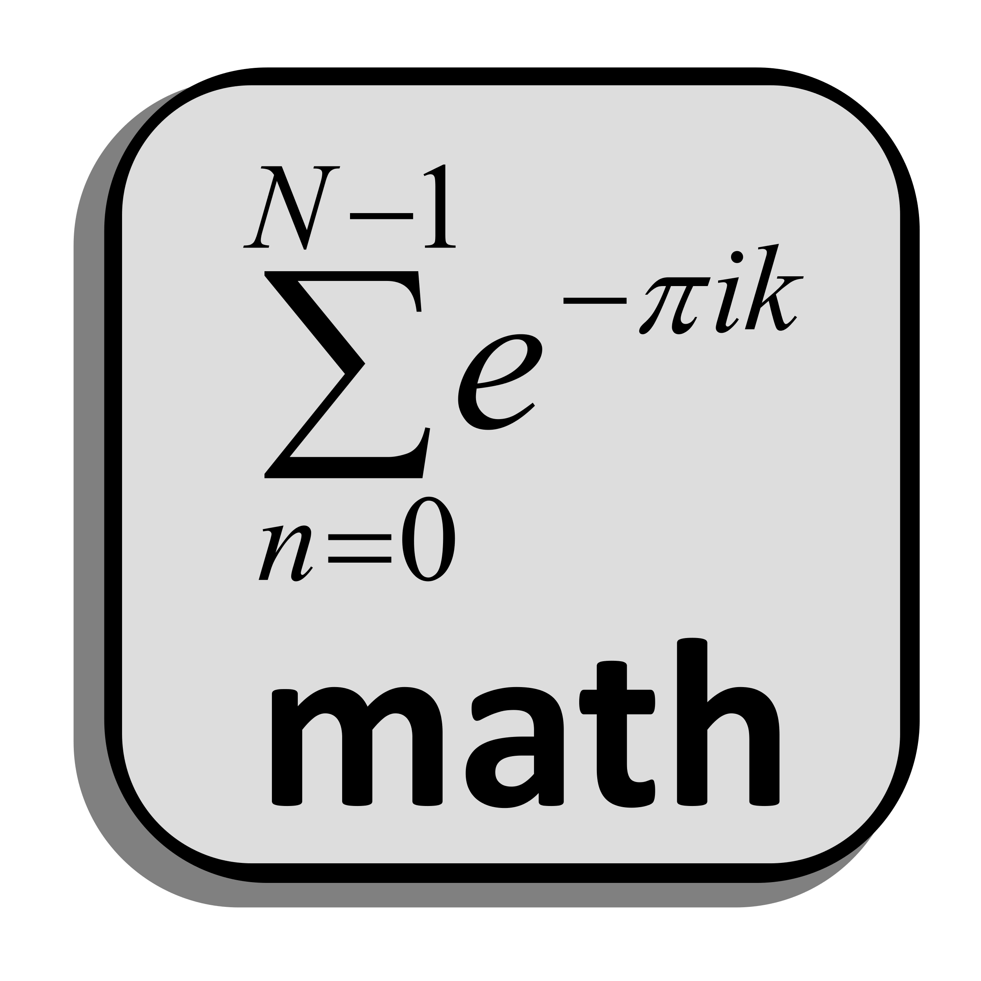
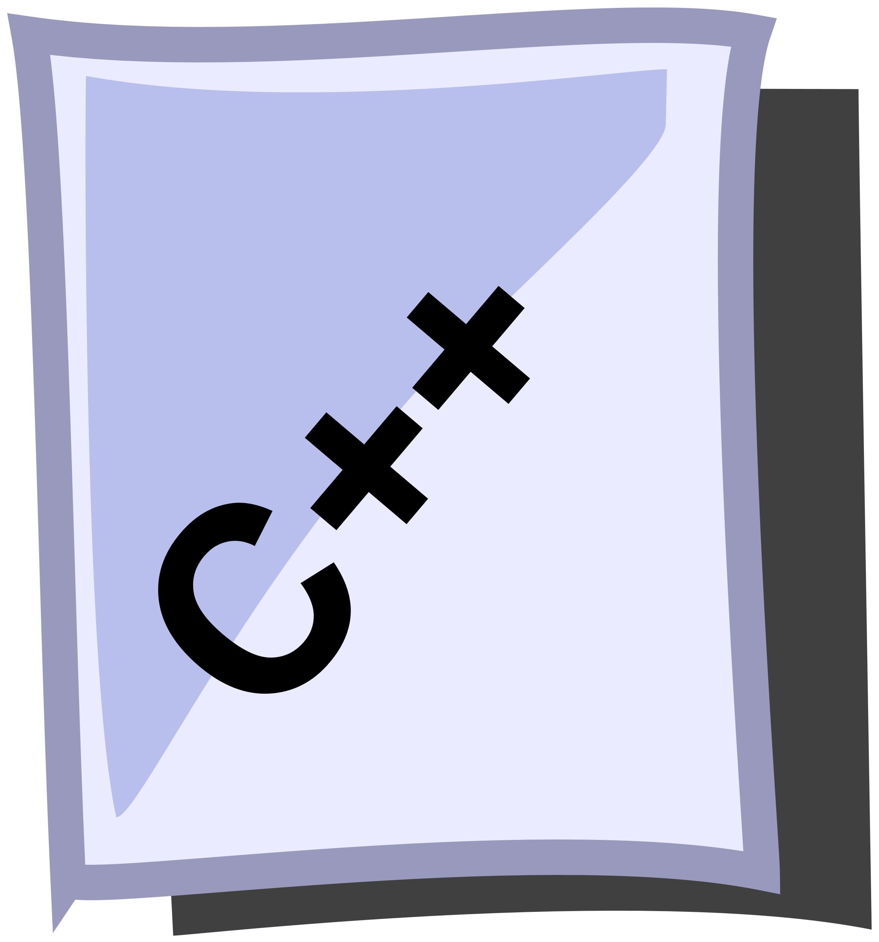

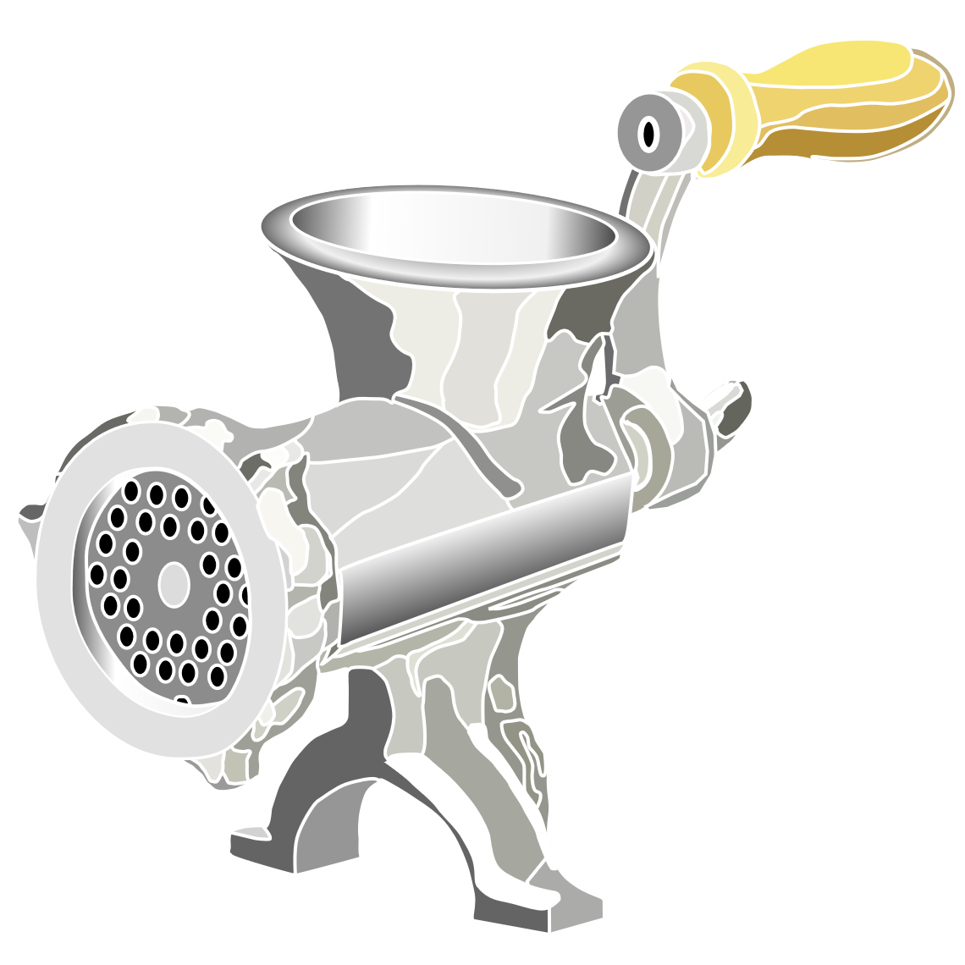
Assembly & Systems Languages
For performance, source is often compiled directly into machine code:
Compiler
Ye Olde Machine Code
01001011010010
11011101010101 0101000111000
0000111101010
1110111010101
0101000101011
0000111010110
Notes:
0.5 min

Slide 3


Managed Languages
In managed languages, the byte code and VM allow for cross-platform use:
Compiler
Ye Olde Byte Code
VM
Ye Olde Machine Code
Java
01001011010010
11011101010101 0101000111000
0000111101010 1110111010101
0101000101011
01001011010010
11011101010101 0101000111000
0000111101010
1110111010101
0101000101011
One Time
Every Time
Notes:
2 min

Slide 4


Scripting Languages
We can achieve flexibility – at the cost of performance – through interpretation:
Interpreter
VM
Ye Olde Machine Code
01001011010010
11011101010101 0101000111000
0000111101010
1110111010101
0101000101011
Every Time
Interpreters generally process code line-by-line.
Notes:
1 min

Slide 5
What is Python?
Python is a scripting language designed with simplicity as a core tenet.
Beautiful is better than ugly.
Explicit is better than implicit.
Simple is better than complex.
Complex is better than complicated.
From The Zen of Python (PEP 20) [See also: Pythonic]
Notes:
1.5 min

Slide 6
Interactive Python
We can directly run lines of code through the console (interactive) interpreter:
jjb@localhost:~$ python3
Python 3.8.0 (default, Oct 28 2019, 16:14:01)
[GCC 8.3.0] on linux
Type "help", "copyright", "credits" or "license" for more information.
>>> print("Ride the snake!!!")
Ride the snake!!!
>>> a = 40
>>> b = 2
>>> c = a + b
>>> c
42
>>> exit()
jjb@localhost:~$
Identifier rules are like other languages: letters, underscores, digits*
Notes:
The interpreter comes up as interactive console; it passes instructions to the VM to be run from the standard input.
That means we can type any line of valid code, and it will be executed on the spot.
You’ll notice that there are no semicolons at the end of lines – and that’s not the only difference (more coming up).
Look ma – no variable types! Variables are dynamic references, and they can be assigned to instances of different types. There are no primitives!
3 min

Slide 7
Python Source Files
Python source files have little required structure – but there are guidelines.
hello.py
01
02
03
04
print("Hello world!")
print("Goodbye cruel world...")
print(fake_variable_name)
jjb@localhost:~$ python3 hello.py
Hello world!
Goodbye cruel world...
Traceback (most recent call last): …
string literal
01
02
03
04
05
06
07
def main():
print("Hello world!")
print("Goodbye cruel world...")
main()
if __name__ == "__main__":
main()
jjb@localhost:~$ python3 hello.py
jjb@localhost:~$
← ???
jjb@localhost:~$ python3 hello.py
Hello world!
Goodbye cruel world...
jjb@localhost:~$
execution name
main script
A dunder (double-underscore) is a variable with special meaning.
Notes:
Source files are executed line by line – if the syntax is “right”, but the symbols are wrong, it won’t catch the errors!
That means that we could just have a bunch of lines of code in the source - the end.
We might want a main function, so I'll declare one (main).
Note that Python doesn't have curly braces; instead, we have to indent consistently - I use two or four spaces.
But if we run with just the main defined, nothing happens! Why?
It’s because we're declaring a function *object* (more later), but we aren't ever invoking it!
We'll have to invoke it in the source by calling the function – using “main()”.
Unfortunately, this is sort of messy. What if we wanted to use this code later in another project?
Thankfully, the “__name__” dunder is automatically declared by the interpreter when executing from stdio, originating script, or interpreter.
9 min

Slide 8
Best Practices
Python Style Guide (PEP 8):
Match existing style
Avoid unnecessary space
docstring, dunders, imports, code
01
02
03
04
05
06
08
09
10
11
12
13
14
15
16
17
18
19
20
21
22
"""This is the sandwich module. As you might expect,
This module makes a sandwich.
"""
__author__ = "Earl of Sandwich"
import lunchmeat.Spam
import breadslice.Wheat
def make_sandwich(top, filling, bottom):
# The __add__ operator is overloaded here.
return top + filling + bottom
def main():
spammer = make_sandwich(Wheat(), Spam(), Wheat())
if __name__ == "__main__":
main() # Call main function
Identifier Type
Modules | short
Var, & Func. | lower_snake_case
Classes | UpperCamelCase
Constants | UPPER_SNAKE_CASE
four space indent
No braces!
Identifiers should be descriptive and meaningful! (I.e., not “a”, “b”…)
Notes:
4 min

Slide 9
Identifiers: What’s in a Name?
Identifiers in languages (including Python) must follow some rules:
Must start with an alpha or underscore character
Contain only alpha, digit, and underscore characters
Can’t be a keyword (e.g., “def” or “for”)
False | await | else | import | pass
None | break | except | in | raise
True | class | finally | is | return
and | continue | for | lambda | try
as | def | from | nonlocal | while
assert | del | global | not | with
async | elif | if | or | yield
Notes:
1 min

Slide 10
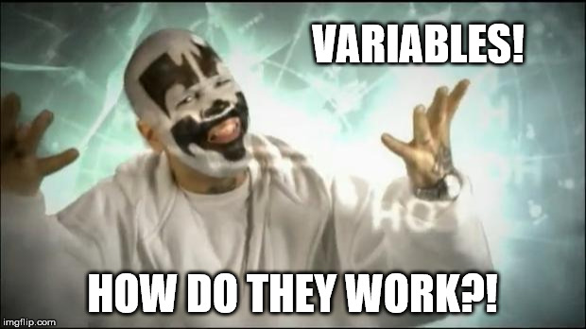
Variables: They are Things
Python has several built-in data types:
Category | Name | Description
None | None | Python‘s null type
Numeric | int | Integers
 | float | Floating point numbers
Iterable | list | Mutable list of elements (sequence)
 | tuple | Immutable list of elements (sequence)
 | str | Immutable run of code points (sequence)
 | range | Immutable run of integers (not sequence)
Other Collections | set | Unordered collection of distinct elements
 | dict | Unordered map of distinct keys to values
Note: Python variables do not have a fixed type. There is no way to declare it anyway!*
Note that this is not an exhaustive list! There are others (file, object, etc.)
Notes:
6 min

Slide 11
Arithmetic Operators
Python arithmetic has some familiar and some new symbols:
Name | Operator | Function | Example | Val | Prc
Parentheses | () | Elevate precedence / grouping | (3 + 4) * 4 | 28 | 1
Exponentiation | ** | Raise a number to an exponent | 3 ** 2 | 9 | 2
Negative / Positive | -, + | Designate sign | -(5) | -5 | 3
Multiply / Divide / Modulus | *, /, % | Multiply or divide numbers | 7 / 2 | 3.5 | 4
Divide-with-Floor | // | Divide & apply floor (int. divide) | 7 // 2 | 3 | 4
Matrix Multiply* | @ | Multiply matrices (dot-product) | *LATER! ☺ | - | 4
Addition / Subtraction | +, - | Add or subtract two numbers | 3 – 3.5 | -0.5 | 5
In addition, Python has string concatenation (+) and compound assignment (+=).
Notes:
3.5

Slide 12
Simple Input & Output
Here’s a simple IO example in a Python function.
cheezbrgr.py
01
02
03
04
05
06
08
09
10
11
def main():
print("What kindah cheezbrgr u wantz?")
sammich = input()
print("How maniez?", end='')
count = int(input())
print("Okees,", count, sammich, "cheezbrgrz!!!")
if __name__ == "__main__":
main() # Call main function
Read string
Read string, convert to int
What kindah cheezbrgr u wantz?
BIG HONKIN
How manies?
Okees, 10 BIG HONKIN cheezbrgrz!!!
10
The input() function reads the entire input – not just one “part”!
Notes:
6 min
Total: 38.5 min
46 min

